Slide 1
Running R on AWS

Slide 2
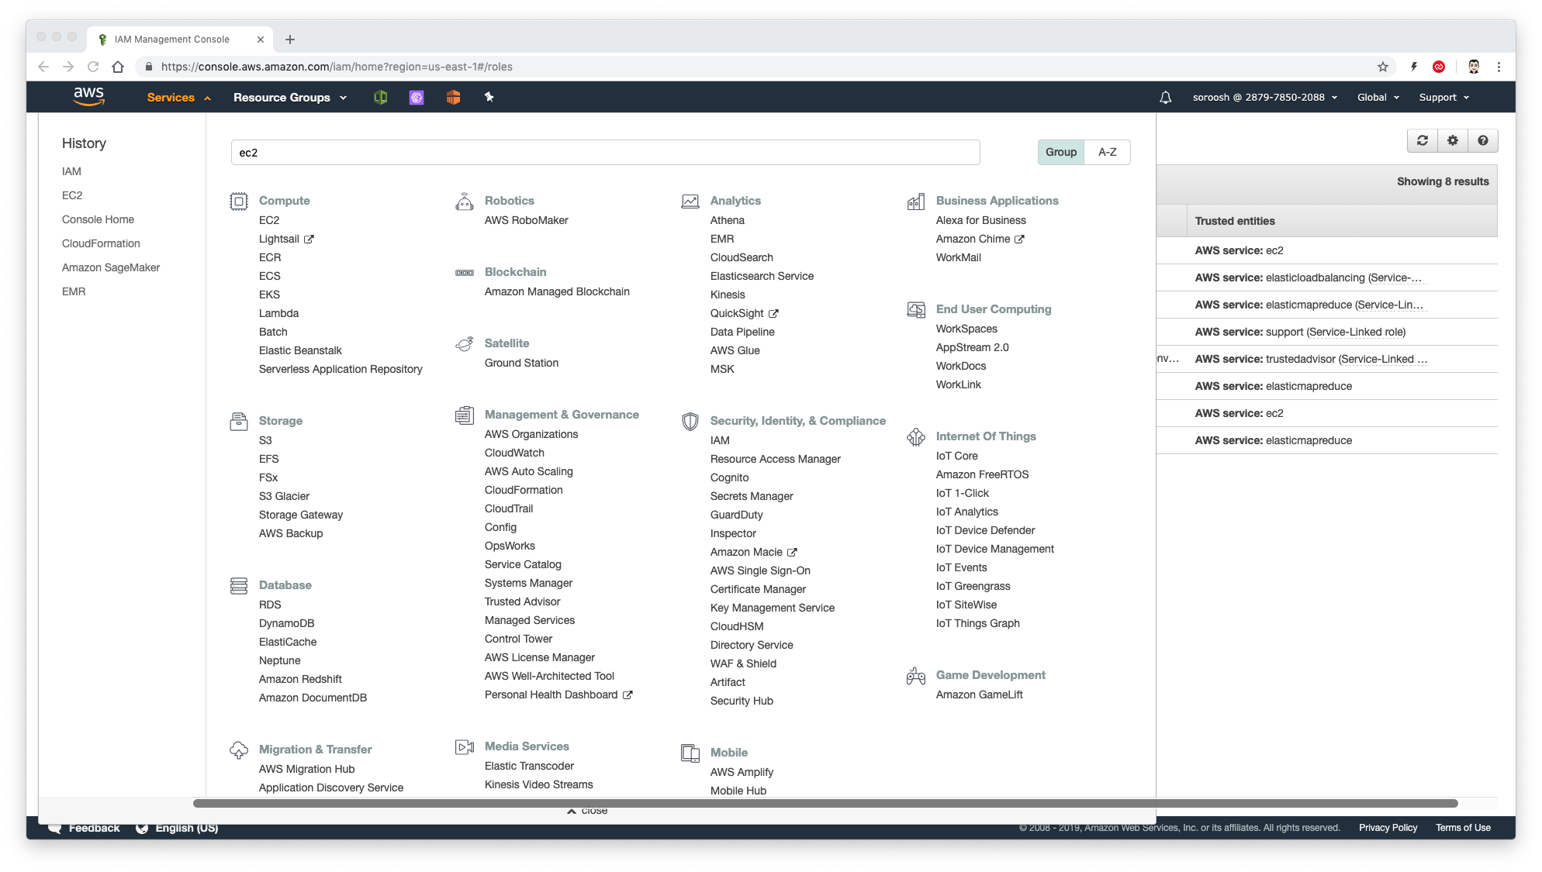
Launch EC2
Navigate to EC2.

Slide 3
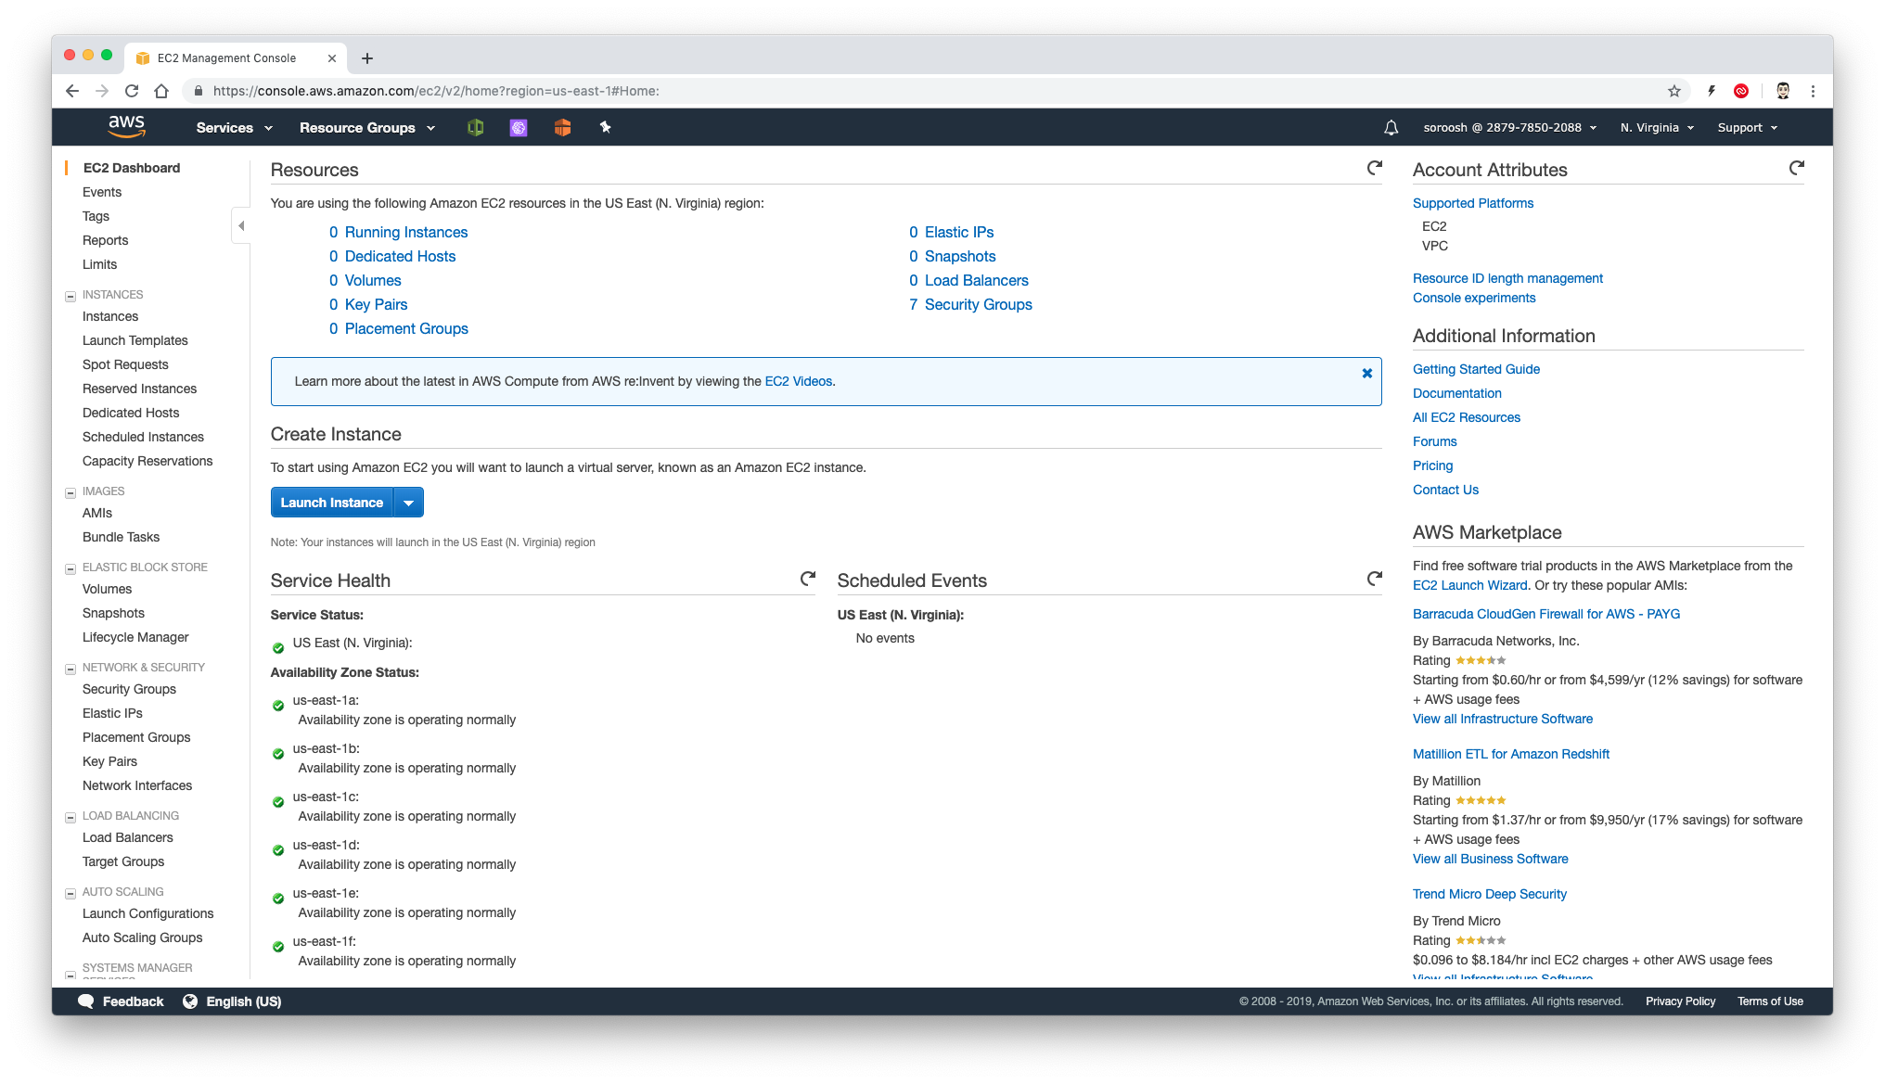

Launch EC2
You can see running instances or launch a new instance here. Please click on Lunch Instance.

Slide 4
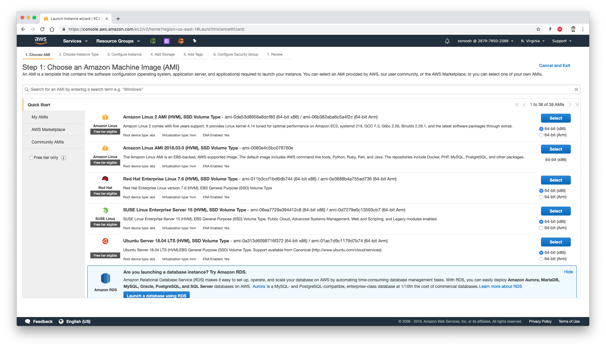

Choose an Amazon AMI
An AMI is a template that contains the software configuration (operating system, application server, and applications) required to launch your instance. You can select an AMI provided by AWS, our user community, or the AWS Marketplace; or you can select one of your own AMIs.

Slide 5
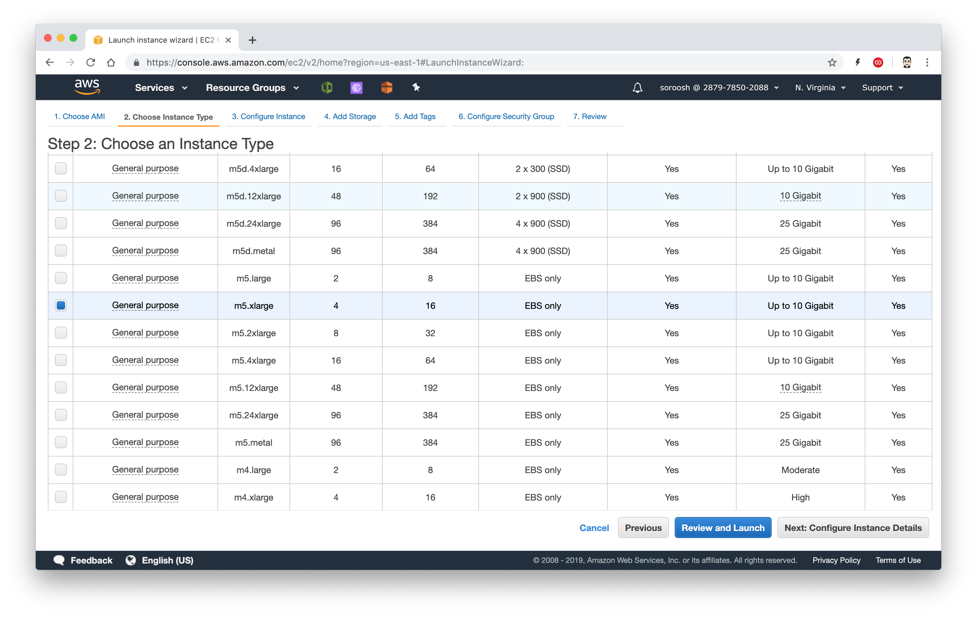


Choose an Instance Type
Amazon EC2 provides a wide selection of instance types optimized to fit different use cases. Instances are virtual servers that can run applications. They have varying combinations of CPU, memory, storage, and networking capacity, and give you the flexibility to choose the appropriate mix of resources for your applications.

Slide 6
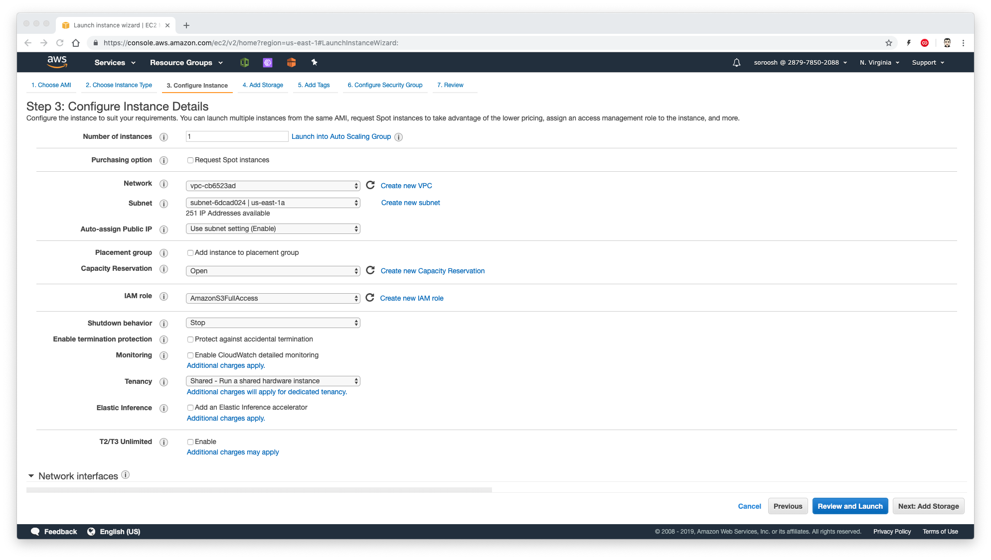
Configure Instance
Configure the instance to suit your requirements. You can launch multiple instances from the same AMI, request Spot instances to take advantage of the lower pricing, assign an access management role to the instance, and more.

Slide 7
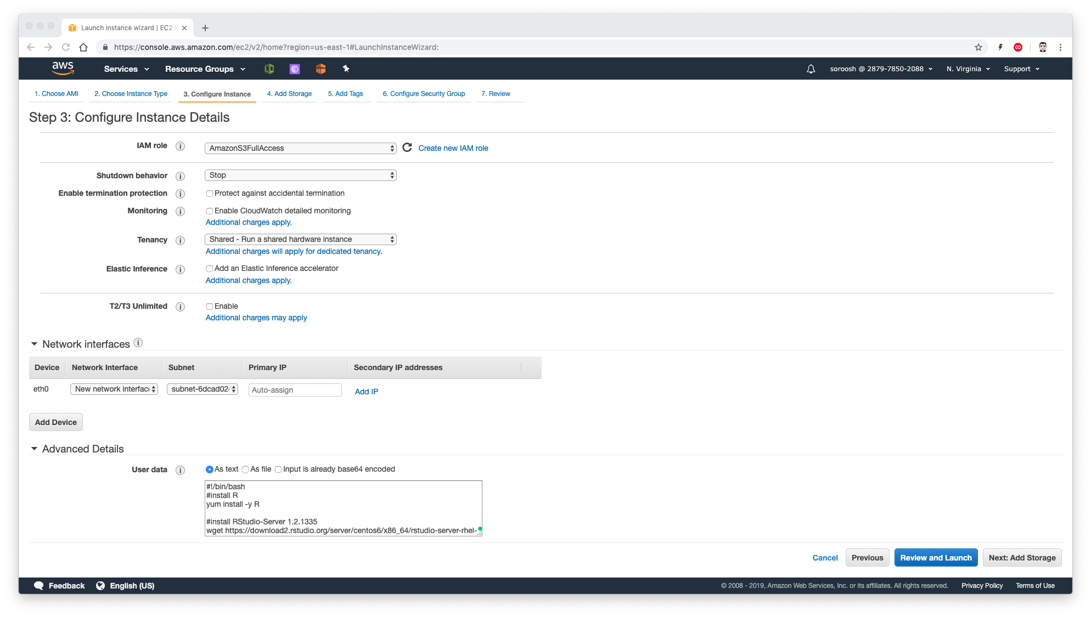


User Data
User data runs after the instance is created. We use it to install R, RStudio Server and a new user to login in RStudio Server.

Slide 8
User_data
shiny-user and shinypass are the username and password to login to RStudio Server.
You can change it with any other name or pass your like!
#!/bin/bash
#install R
sudo yum update -y
sudo amazon-linux-extras install -y R3.4
# Download RStudio Server
wget https://download2.rstudio.org/server/centos6/x86_64/rstudio-server-rhel-1.2.1335-x86_64.rpm
# Install RStudio Server
sudo yum install -y rstudio-server-rhel-1.2.1335-x86_64.rpm
rm rstudio-server-rhel-1.2.1335-x86_64.rpm
# needed for RCurl
sudo yum install -y libcurl-devel.x86_64
# add user(s)
useradd shiny-user
echo shiny-user:shinypass | sudo chpasswd
# Start RStudio Server
sudo /usr/sbin/rstudio-server start

Slide 9
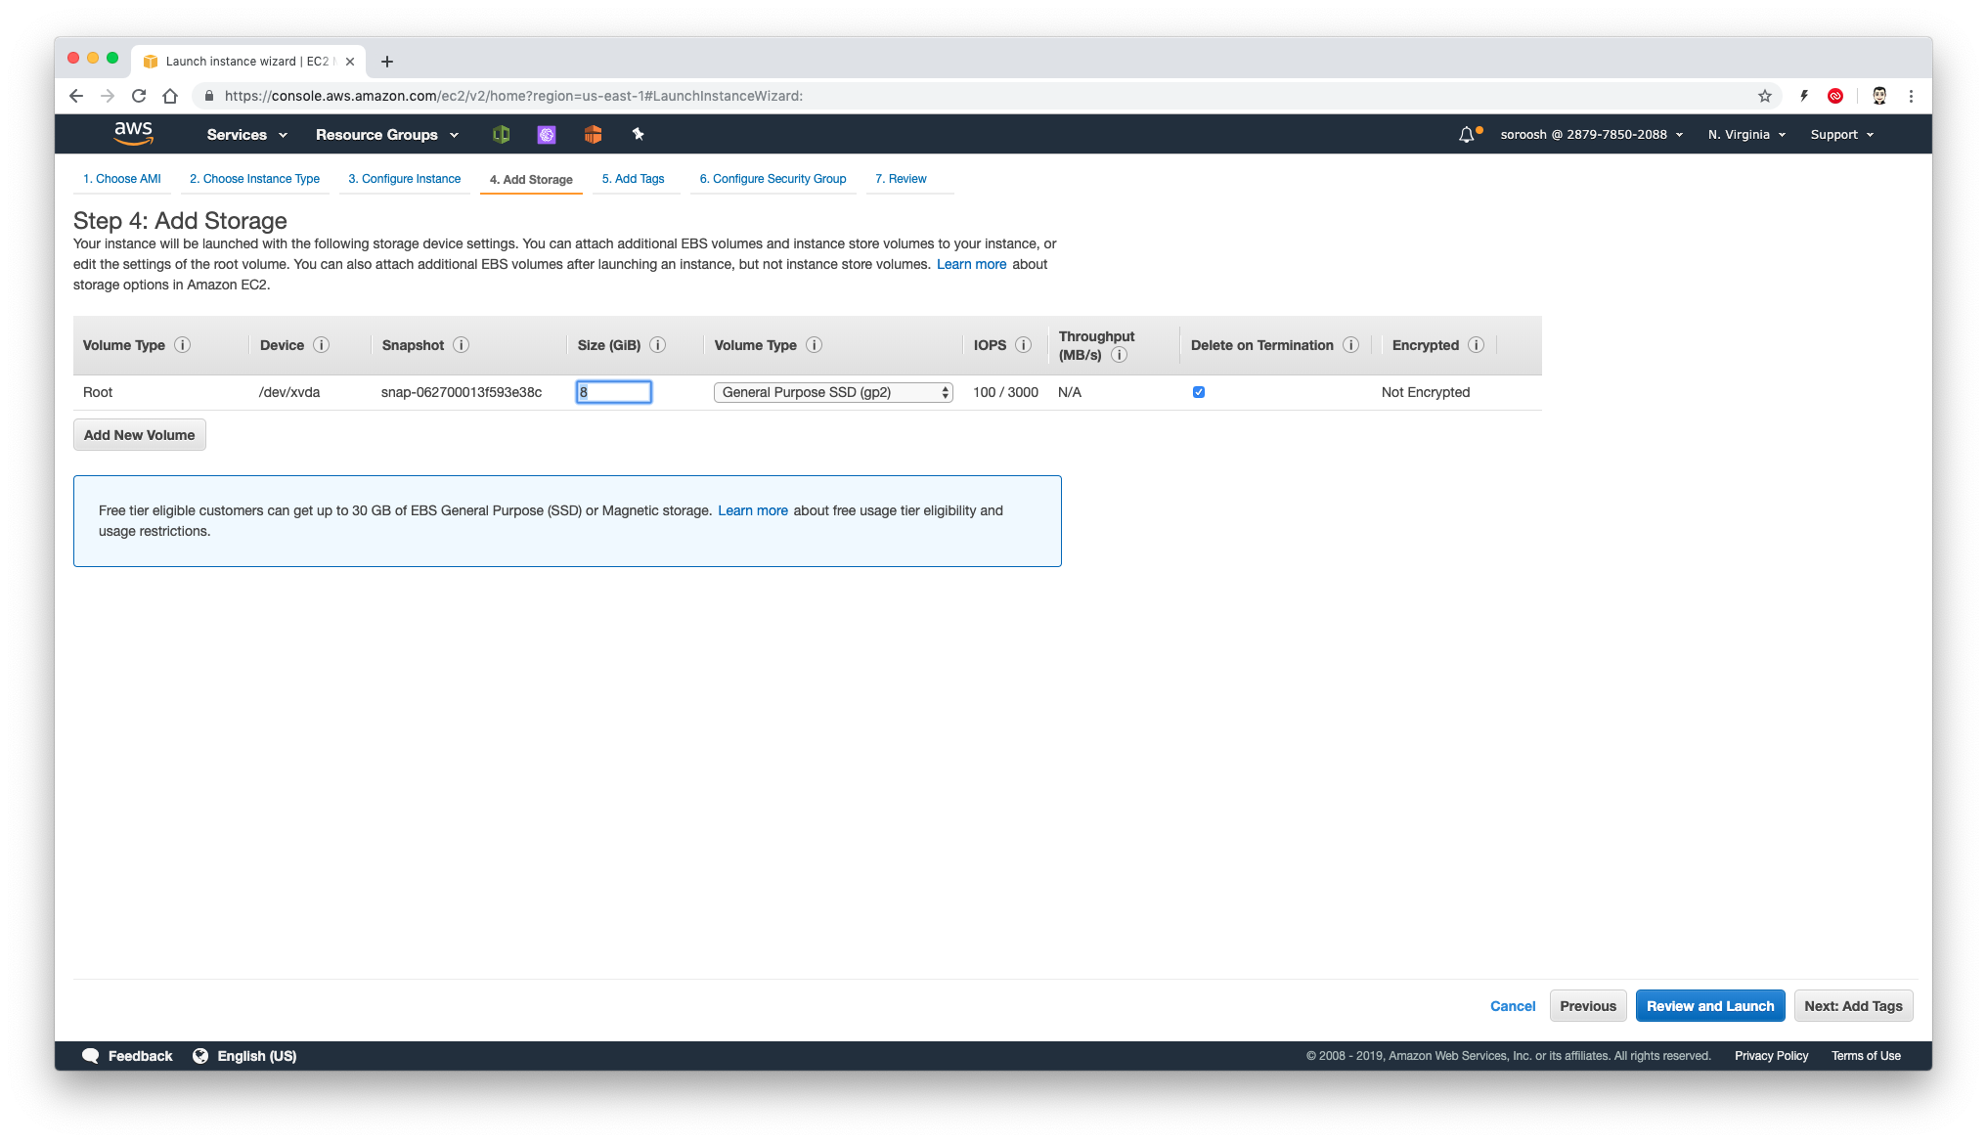
Add Storage
Your instance will be launched with the following storage device settings. You can attach additional EBS volumes and instance store volumes to your instance, or edit the settings of the root volume. You can also attach additional EBS volumes after launching an instance, but not instance store volumes.

Slide 10
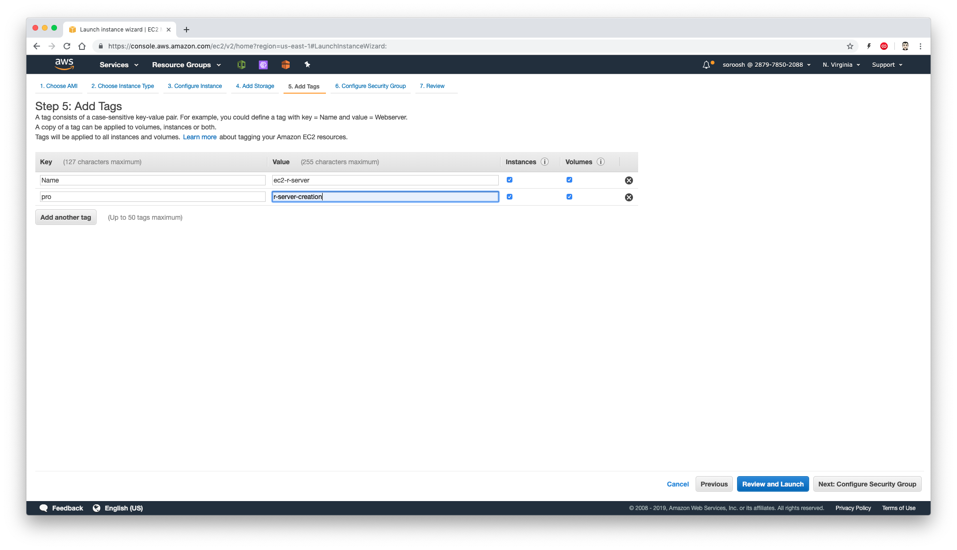


Add Tags
A tag consists of a case-sensitive key-value pair. For example, you could define a tag with key = Name and value = Webserver.
A copy of a tag can be applied to volumes, instances or both.

Slide 11
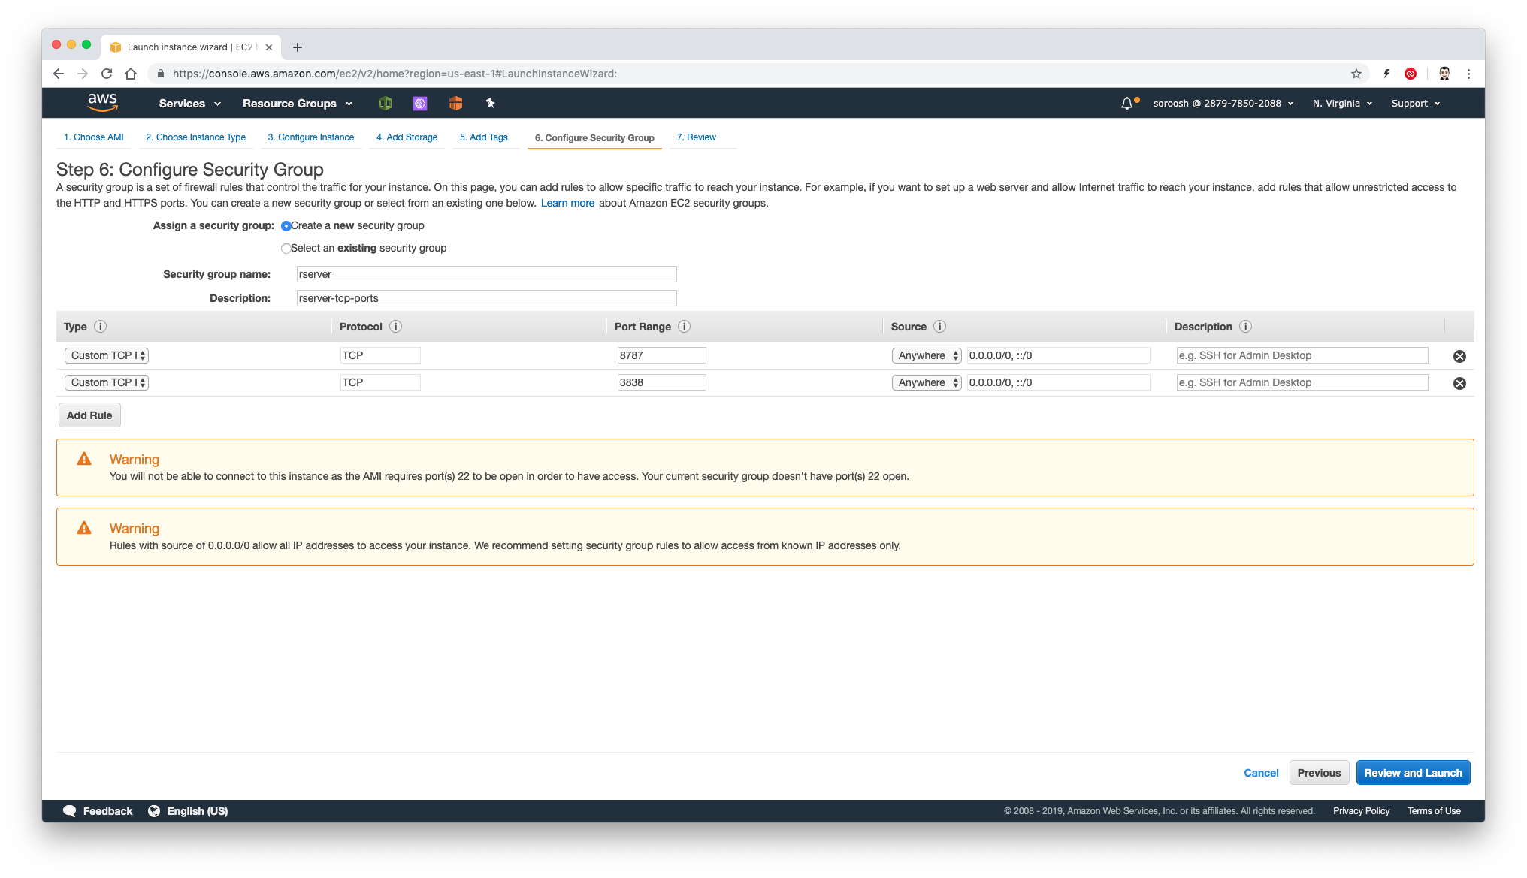

Configure Security Group
A security group is a set of firewall rules that control the traffic for your instance. On this page, we add rules to allow specific traffic to reach your instance. Port 8787 is required to access rstudio server.

Slide 12
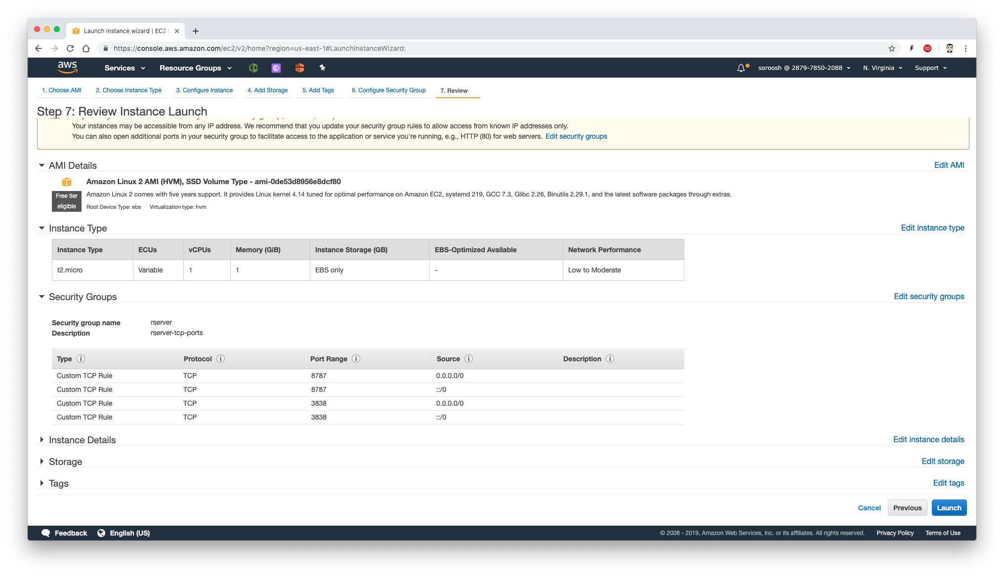

Review and Launch
Please review your instance launch details. You will prompt with key to access the instance. Please use no key for now.

Slide 13
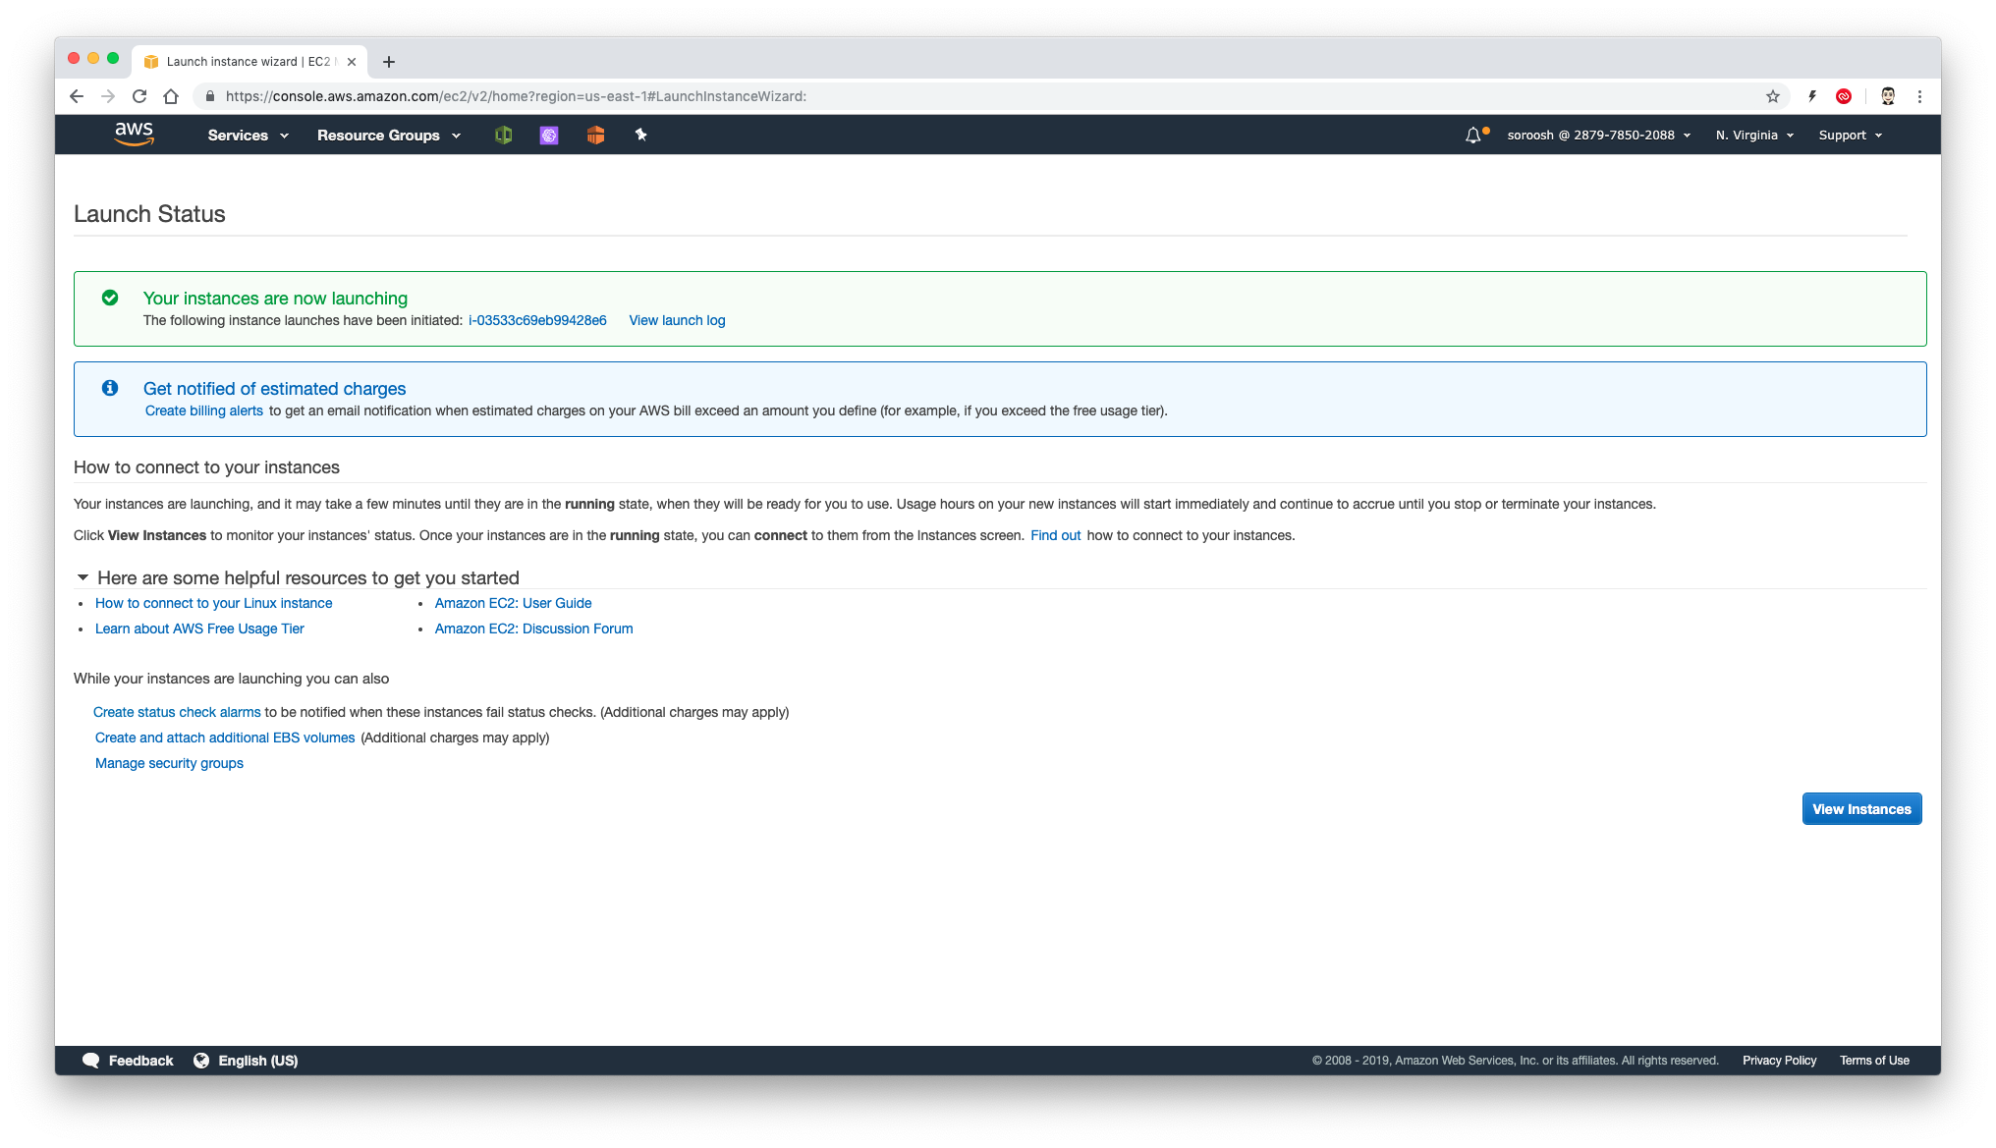
Launch Status

Slide 14
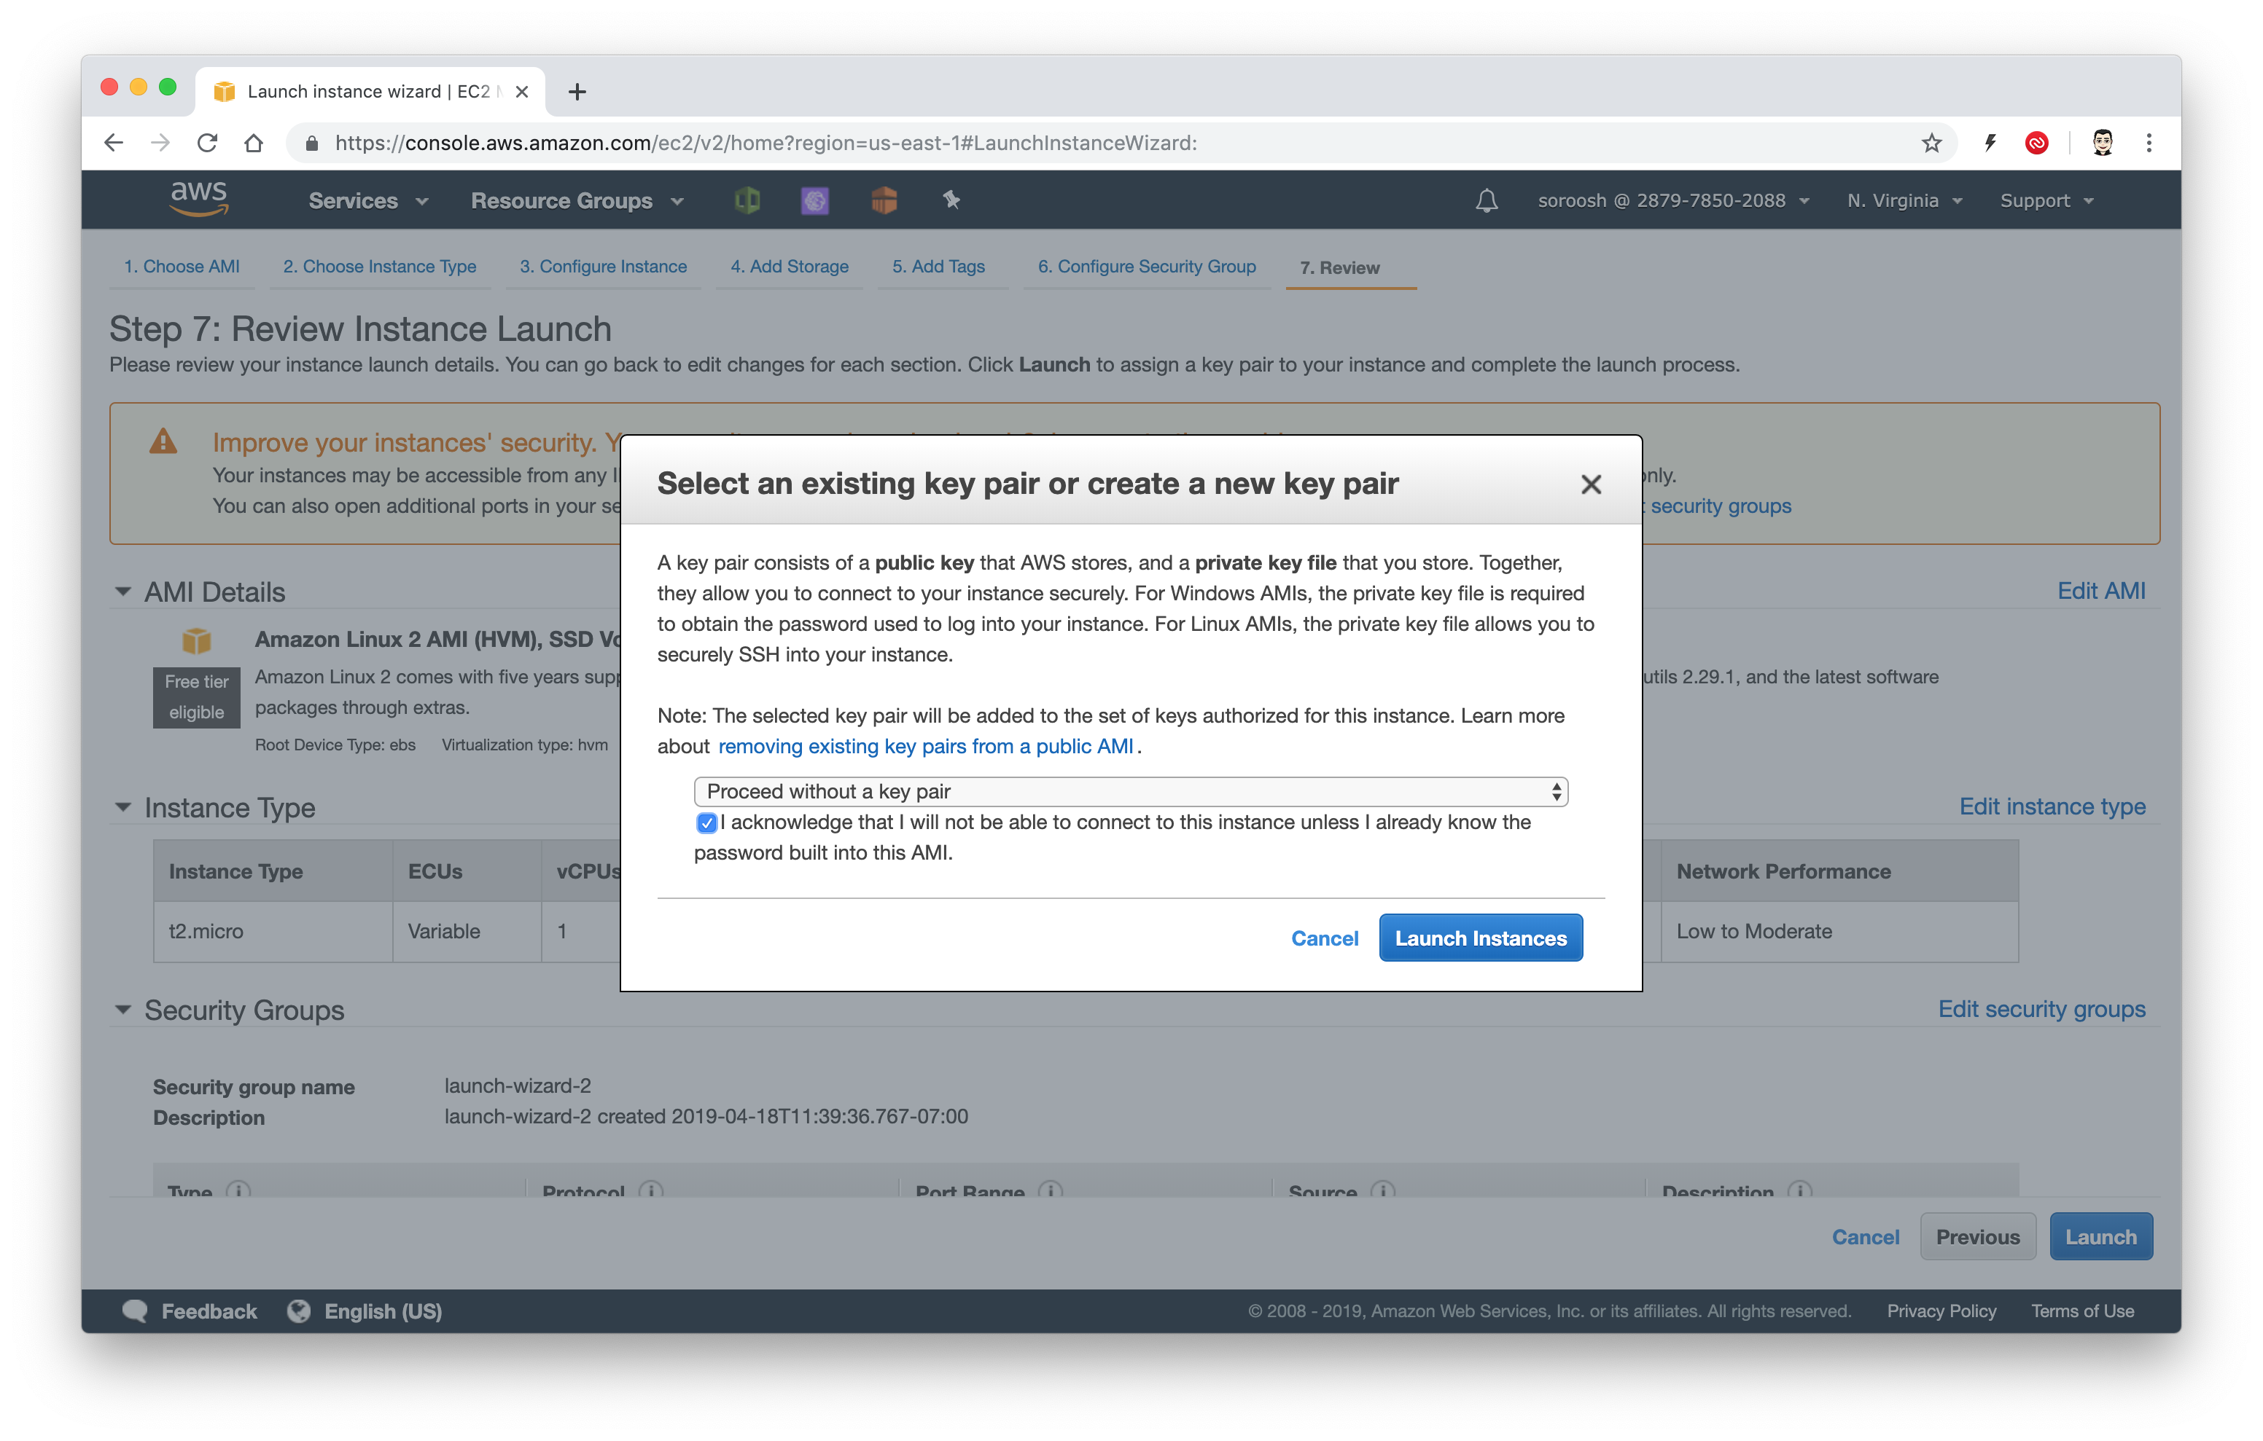


Select a key pair
No key pair is needed for this tutorial. Select “Proceed without a key pari” and click on Launch Instances

Slide 15
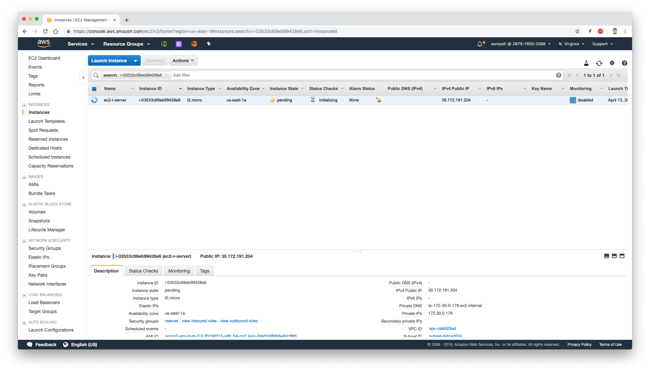
Check the status
Please copy the ip-address of your server under the IPv4 Public IP.

Slide 16
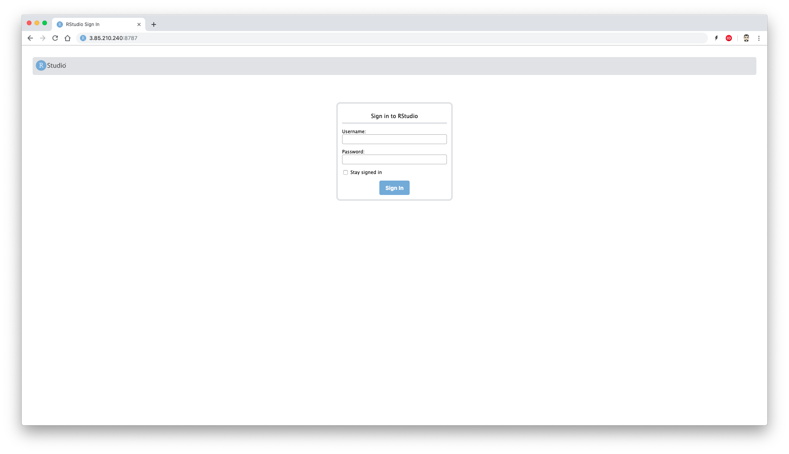
Login
Now open your browser and navigate to http://<server-ip>:8787

Slide 17
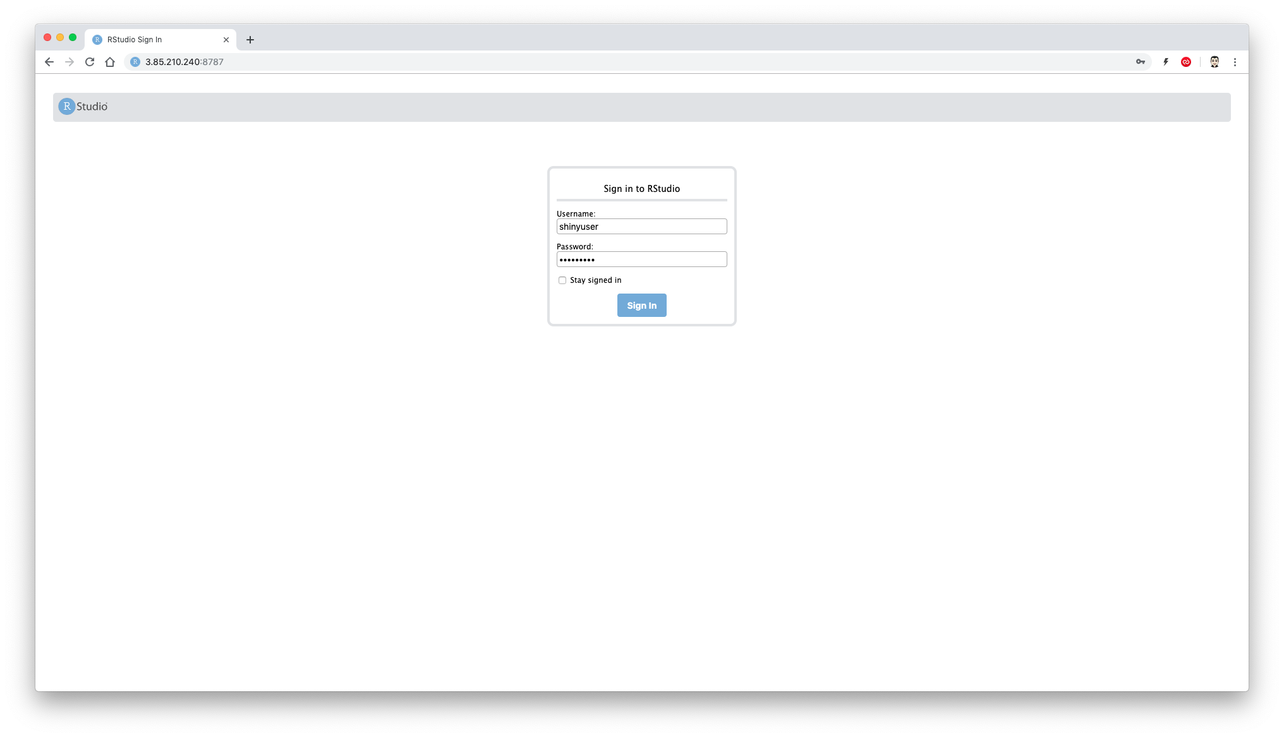
RStudio
Enter the username and password which was used in user data to login to rstudio server.

Slide 18
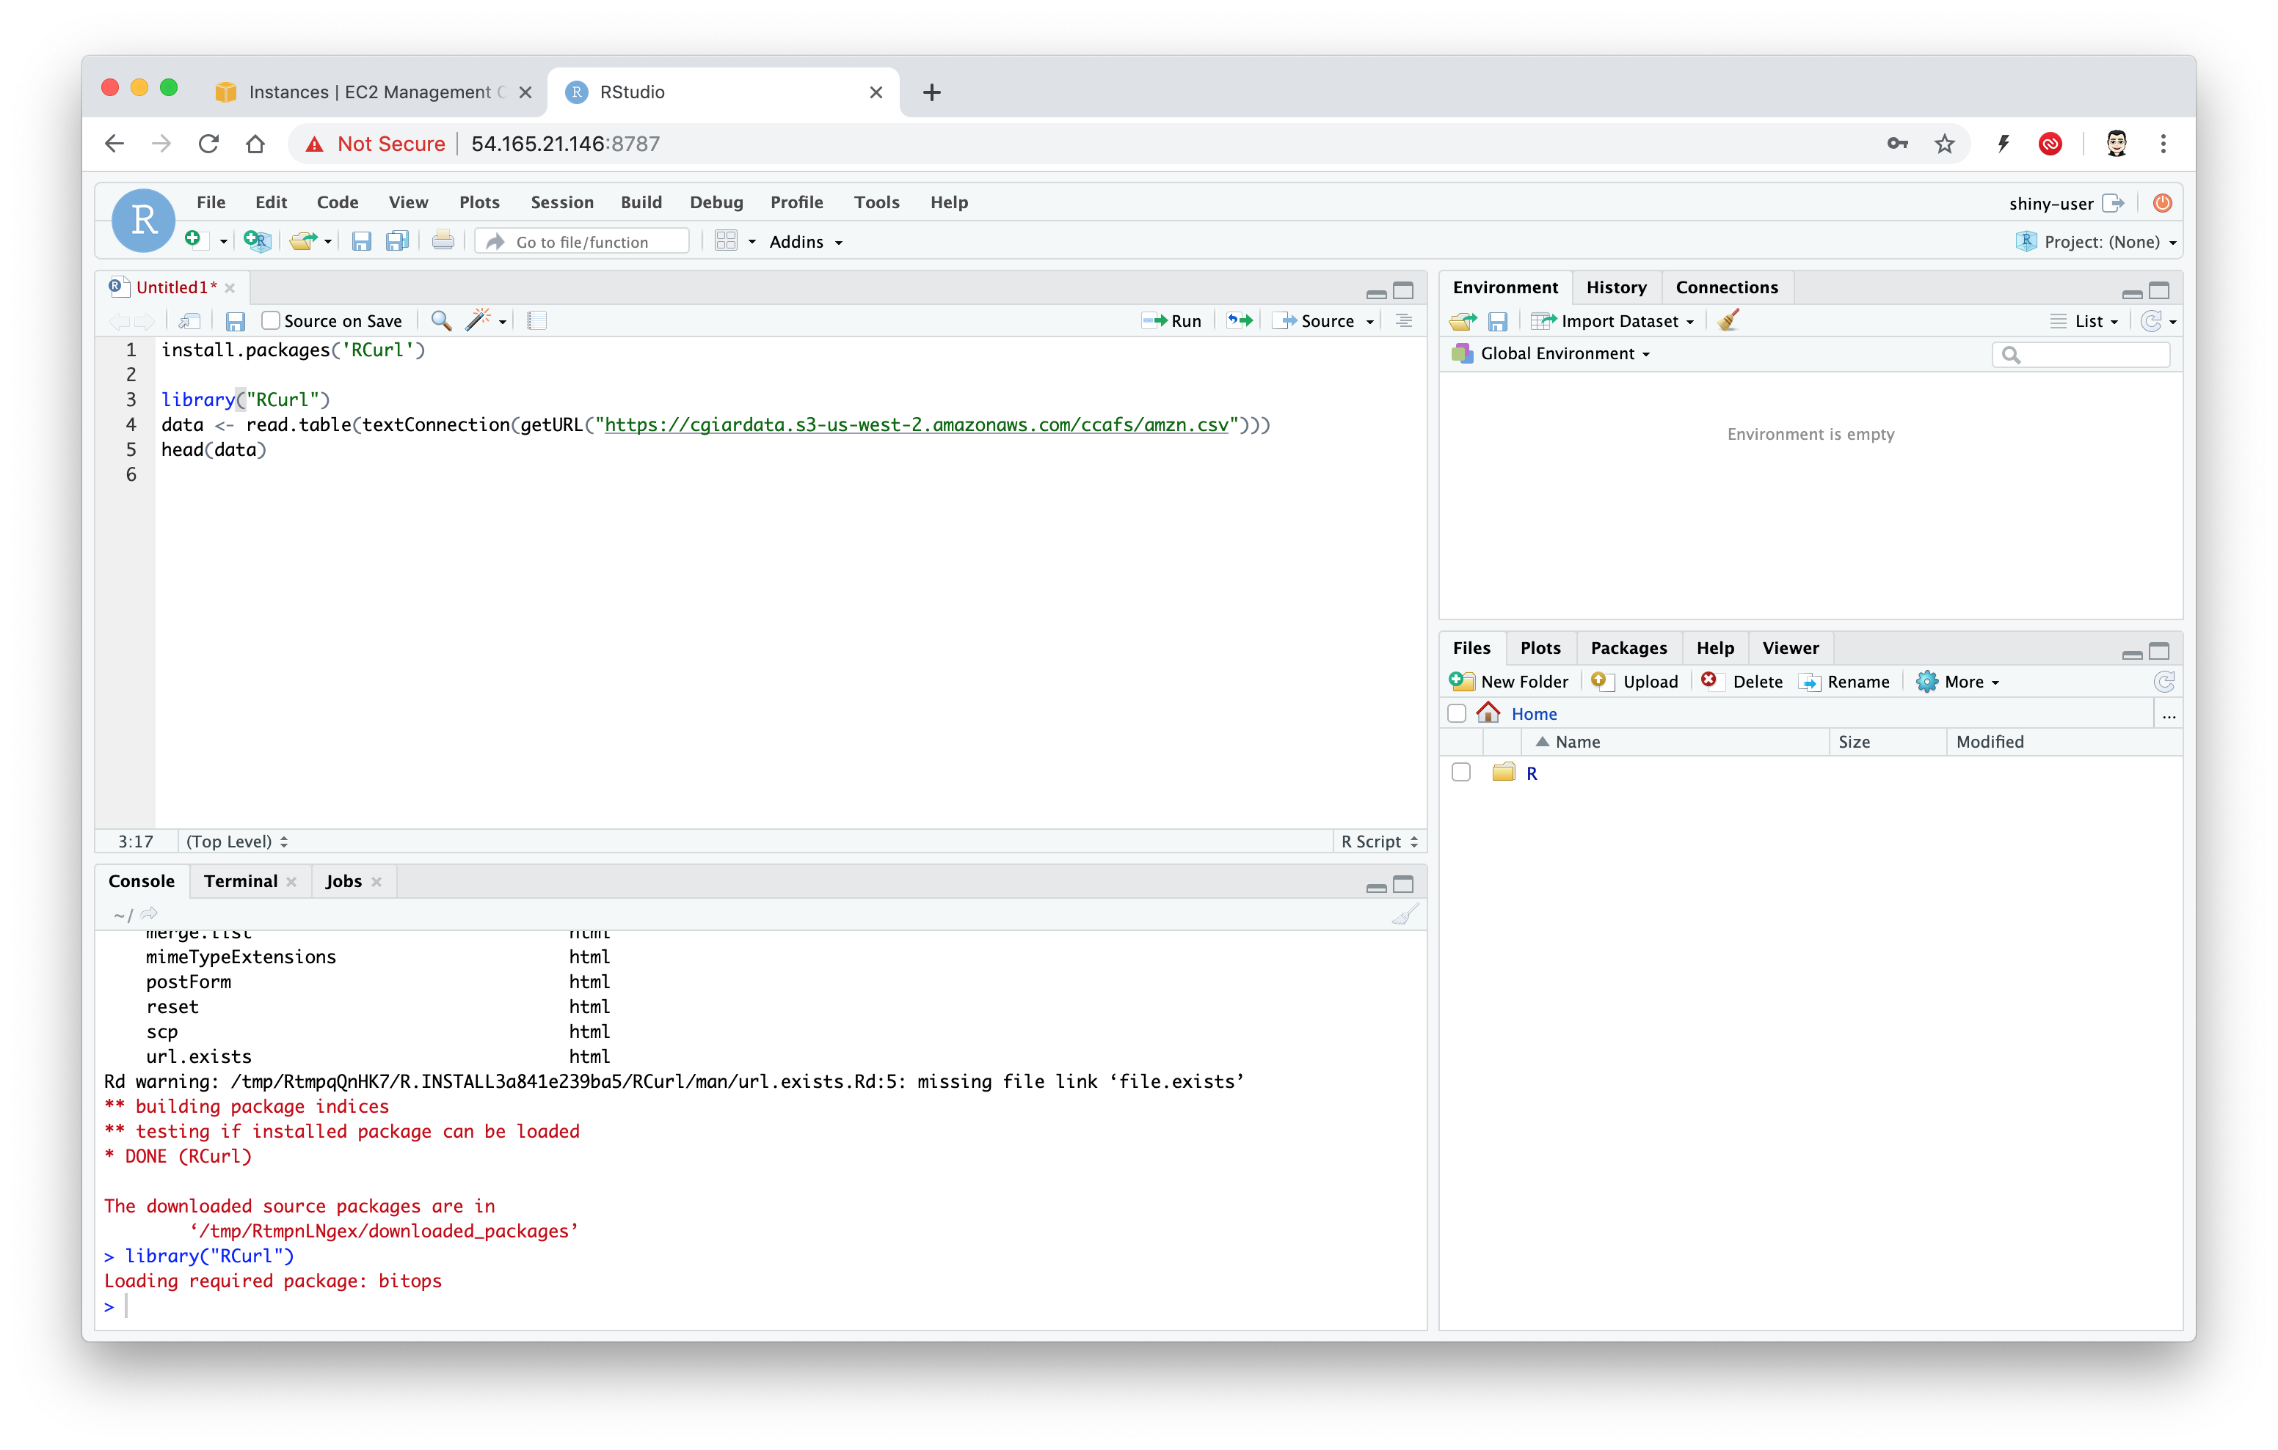
RStudio
Install RCurl, download a csv file and run some code.

